Slide 1
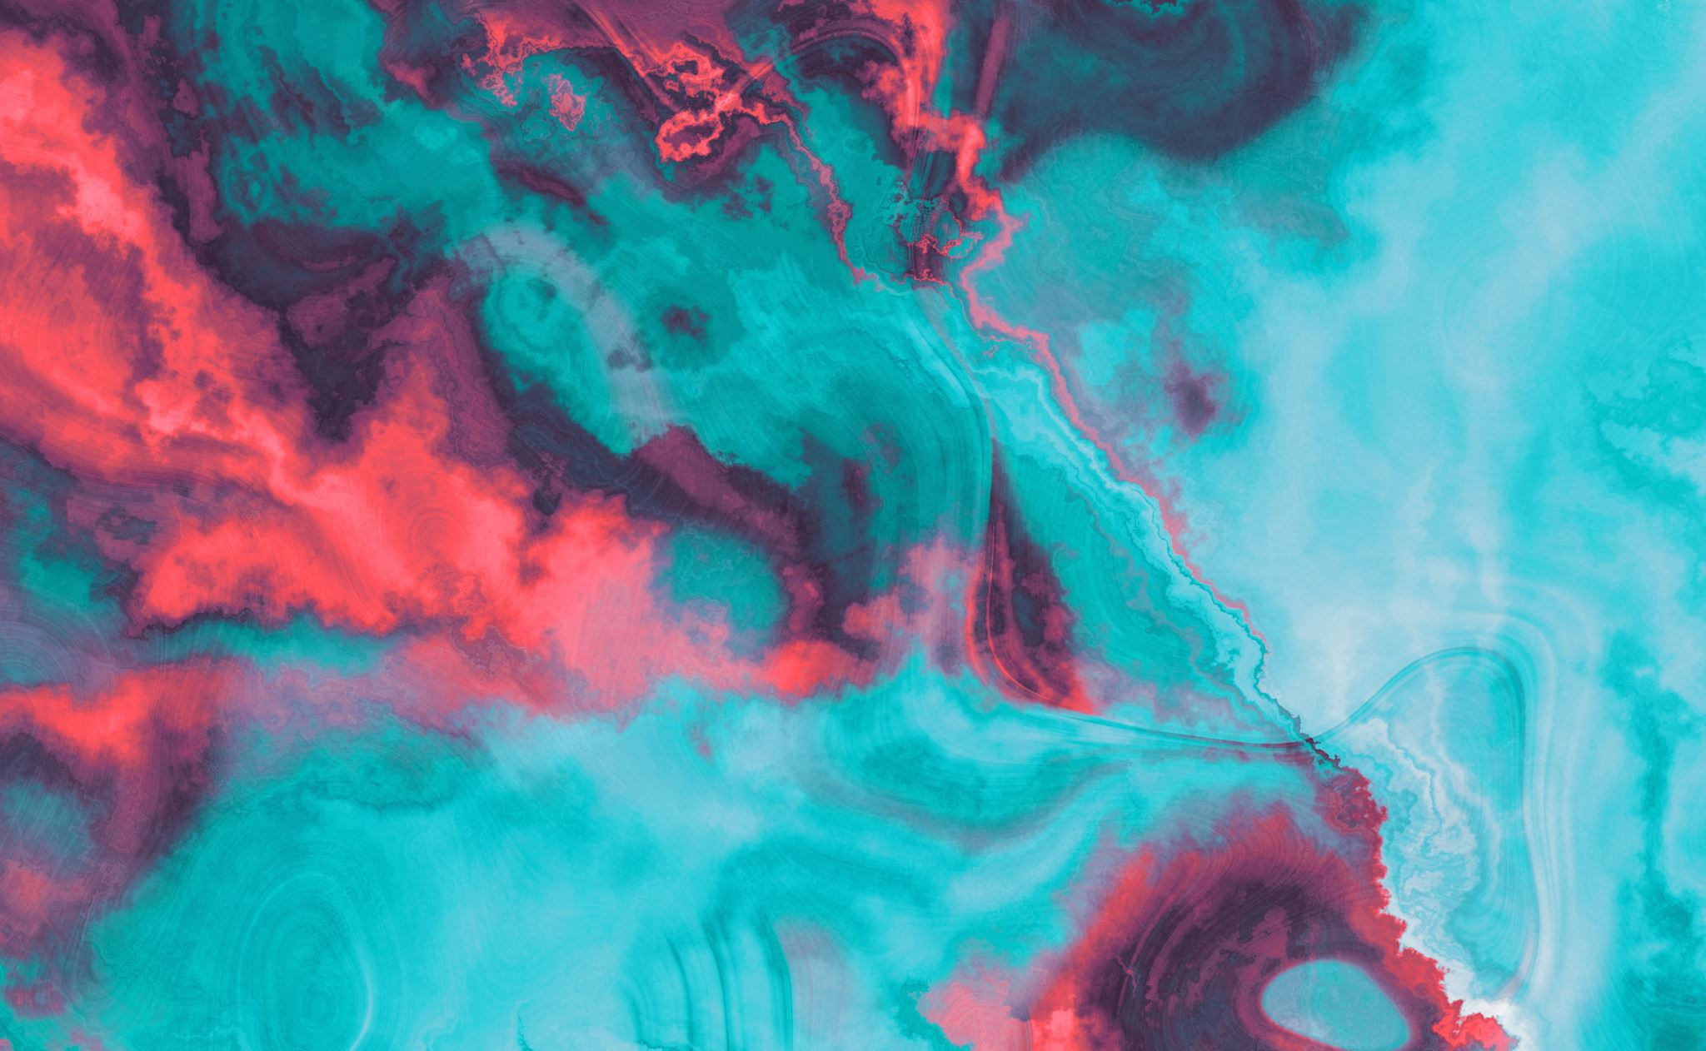
The Influence of Energy Drinks on Health
By
David Wederstandt

Slide 2
An estimated 154 million adults (75% of the us population) drink coffee

Slide 3
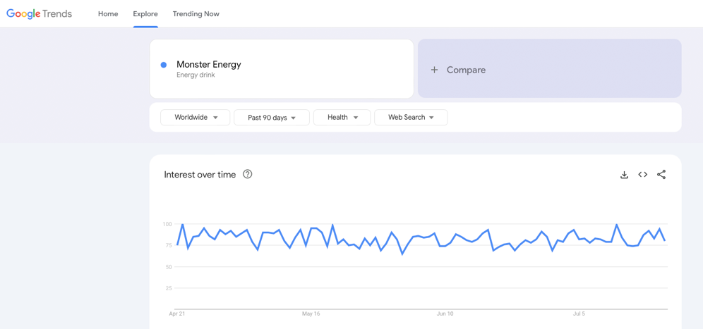
Google Trends shows worldwide health searches for Monster energy drink
Figure 1: Monster Energy (Google Trends2024)

Slide 4
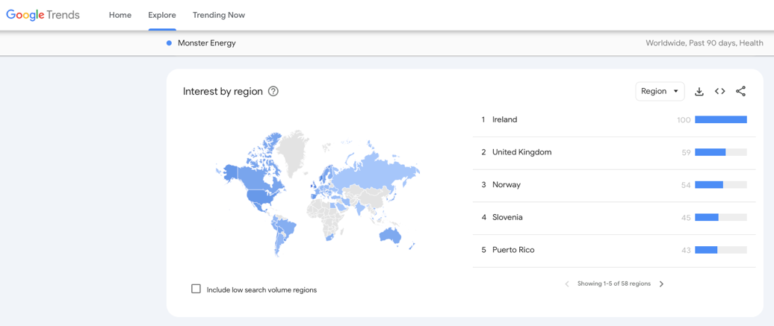
Google Trends shows world ranking by country. Us is 6th
Figure 2: Monster Energy World Rank (Google Trends 2024)

Slide 5
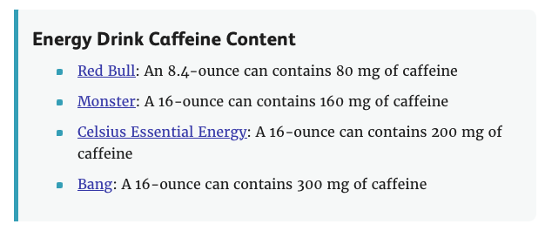
Energy drink caffeine content by brand.
Figure 3: Energy Drink Caffeine Content[JPG] (Brown 2022)

Slide 6
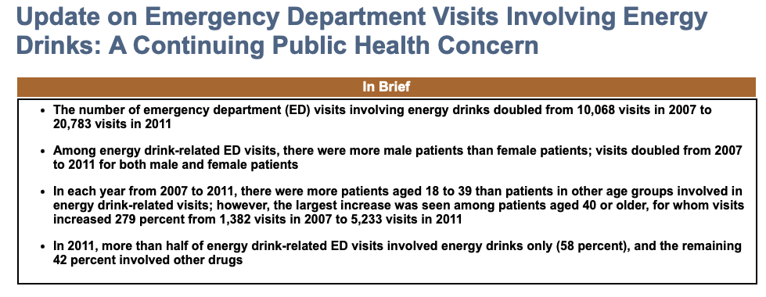
Emergency room visits as a result of energy drink consumption
Figure 4: Emergency Room Visits[JPG] (SAMHSA 2013)

Slide 7
- The adverse effects outweigh the benefits. - Energy drinks should be regulated and require labeling. - Consumption should only be done by adults.
conclusion

Slide 8
Figure 1 & 2 Google. (n.d.). Monster Energy Drink. Google trends. https://trends.google.com/trends/ Brown, S. (2022, July 28). How dangerous are energy drinks? Verywell Health. https://www.verywellhealth.com/energy-drinks-danger-6281116 SAMHSA. (2013, January 10). Update on emergency department visits involving Energy Drinks: A continuing public health concern. The DAWN Report: Update on Emergency Department Visits Involving Energy Drinks: A Continuing Public Health Concern. https://www.samhsa.gov/data/sites/default/files/DAWN126/DAWN126/sr126-energy-drinks-use.htm
references:

